Slide 1
MICRO-CREDIT DEFAULTER MODEL
SUBMITTED BY:
ATISH KALANGUTKAR

Slide 2
Contents
Introduction
Problem Statement
Problem Understanding
Data Analysis & Model Building Flowchart
Exploratory Data Analysis (EDA)
Visualizations
Data Analysis Steps Done
Model Building
ROC-AUC Curve
Hyper Parameter Tuning and Creating Final Model
Saving the model and prediction results
Conclusion

Slide 3
INTRODUCTION
A Microfinance Institution (MFI) is an organization that offers financial services to low income populations. MFS becomes very useful when targeting especially the unbanked poor families living in remote areas with not much sources of income. The Microfinance services (MFS) provided by MFI are Group Loans, Agricultural Loans, Individual Business Loans and so on.
Many microfinance institutions (MFI), experts and donors are supporting the idea of using mobile financial services (MFS) which they feel are more convenient and efficient, and cost saving, than the traditional high-touch model used since long for the purpose of delivering microfinance services. Though, the MFI industry is primarily focusing on low income families and are very useful in such areas, the implementation of MFS has been uneven with both significant challenges and successes.

Slide 4
Problem Statement
A client in telecom industry is collaborating with an MFI to provide micro-credit on mobile balances to be paid back in 5 days. The Consumer is believed to be defaulter if he deviates from the path of paying back the loaned amount within the time duration of 5 days. In order to improve the selection of customers for the credit, the client wants some predictions that could help them in further investment and improvement in selection of customers.
In this project we need to build a model which can be used to predict in terms of a probability for each loan transaction, whether the customer will be paying back the loaned amount within 5 days of insurance of loan. In this case, Label ‘1’ indicates that the loan has been payed i.e. Non- defaulter, while, Label ‘0’ indicates that the loan has not been payed i.e. defaulter.

Slide 5
Problem Understanding
The loan providing companies find it hard to give loans to the people due to their insufficient or non-existent credit history. Because of that, some consumers use it as their advantage by becoming a defaulter. Suppose you work for a consumer finance company which specialises in lending various types of loans to urban customers. You have to use EDA to analyse the patterns present in the data. This will ensure that the applicants are capable of repaying the loan are not rejected.
When the company receives a loan application, the company has to decide for loan approval based on the applicant’s profile. Two types of risks are associated with the bank’s decision:
If the applicant is likely to repay the loan, then not approving the loan results in a loss of business to the company.
If the applicant is not likely to repay the loan, i.e. he/she is likely to default, then approving the loan may lead to a financial loss for the company.

Slide 6



Data Analysis And Model Building Flow Chart
Import Libraries
Import Dataset
Data Preprocessing
Identifying Outliers and Skewness
Visualizations
(EDA)
Feature Engineering
Checking Correlation
Data Balancing
Model Building
Saving the Model & Predictions
ROC-AUC Curve
Hyper Parameter Tuning

Slide 7
Exploratory Data Analysis (EDA)
Importing required libraries and loading the dataset.
Checked some statistical information such as shape of the dataset,unique values and number of unique values present, type of data present in the columns,value counts etc.
Checked for null values but there were no null values present in the dataset.
Checked for duplicates and found one duplicate which was dropped from the dataset.
Dropped unwanted columns like unnamed:0, msisdn and pcircle because they were not relevant at the time of prediction as unnamed was having index values, msisdn was having mobile numbers of the customers and pcircle was having only one unique value.
There were a lot of zero values present in the dataset, so checked with the percentage of the zero values present in each column and the column in which zero value percentage was more than 90% was dropped. So around 7 columns was having zero value percentage more than 90% which was dropped.
Taking care of timestamp variables by converting data types of pdate from object data type into date time data types.
After that checked for the unique values and value counts of the day, month and year in which found that year was having only one unique value which was irrelevant at the time of prediction. That is why column year was dropped.
While checking the statistical summary of the dataset I found that around 8 columns was having negative values which was invalid and unrealistic. That’s why converted the negative values into positive values by using absolute command.
◆

Slide 8
Exploratory Data Analysis (EDA) Cont..
As per to the description it was given that only two loan were given that is 5(in Indonesian Rupiah) and 10(in Indonesian Rupiah) and for 5(in Indonesian Rupiah) payback amount is 6(in Indonesian Rupiah)and for 10(in Indonesian Rupiah) payback amount is 12(in Indonesian Rupiah). And zero means no loan taken. So when I was going through the unique value of maxamnt_loan30(meaning of this is maximum amount of loan taken by user in last 30 days) I found the value other than 0, 6 and 12 which was invalid. So replaced all the values other than 0, 6 and 12 to 0.
Performed uni-variate, bi-variate and multi-variate analysis by plotting distribution plot, count plot, pie plot and bar plot.
Used bar plot to check the correlation between the features and the label and after with the help of heatmap checked whether there is multicollinearity present or not among the features. So found that many features was showing values more than 75% which means there was multicollinearity problem within the features. So further vif method will be used to cross verify whether there is multicollinearity is there or not within the features.
Checked for skewness on numerical data columns and found that most of the columns was having skewness, so by using power transform method skewness was treated of that particular columns.
Checked whether there are any outliers present or not using box plot on numerical data columns and found that many columns was having outliers so by using z-score method removed outliers.The data loss percentage was about 5%.
Separated feature and label data and than feature scaling was done by using Standard Scaler method to avoid any kind of data biasness.
After that I used vif method and found that many columns was having values more than 5 which means that there was a multicollinearity problem within them.So I used PCA technique as it takes care of multicollinearity problems.

Slide 9
Exploratory Data Analysis (EDA) Cont..
So around 19 components was able to explain more than 95% variance. So I had considered starting 19 PC’s.
While going through the plots I found that the data of labels was not balanced. So by using smote technique the data of label was balanced.
Checked for the best random state to be used on our classification models.
Finally created classification models along with evaluation metrics.

Slide 10
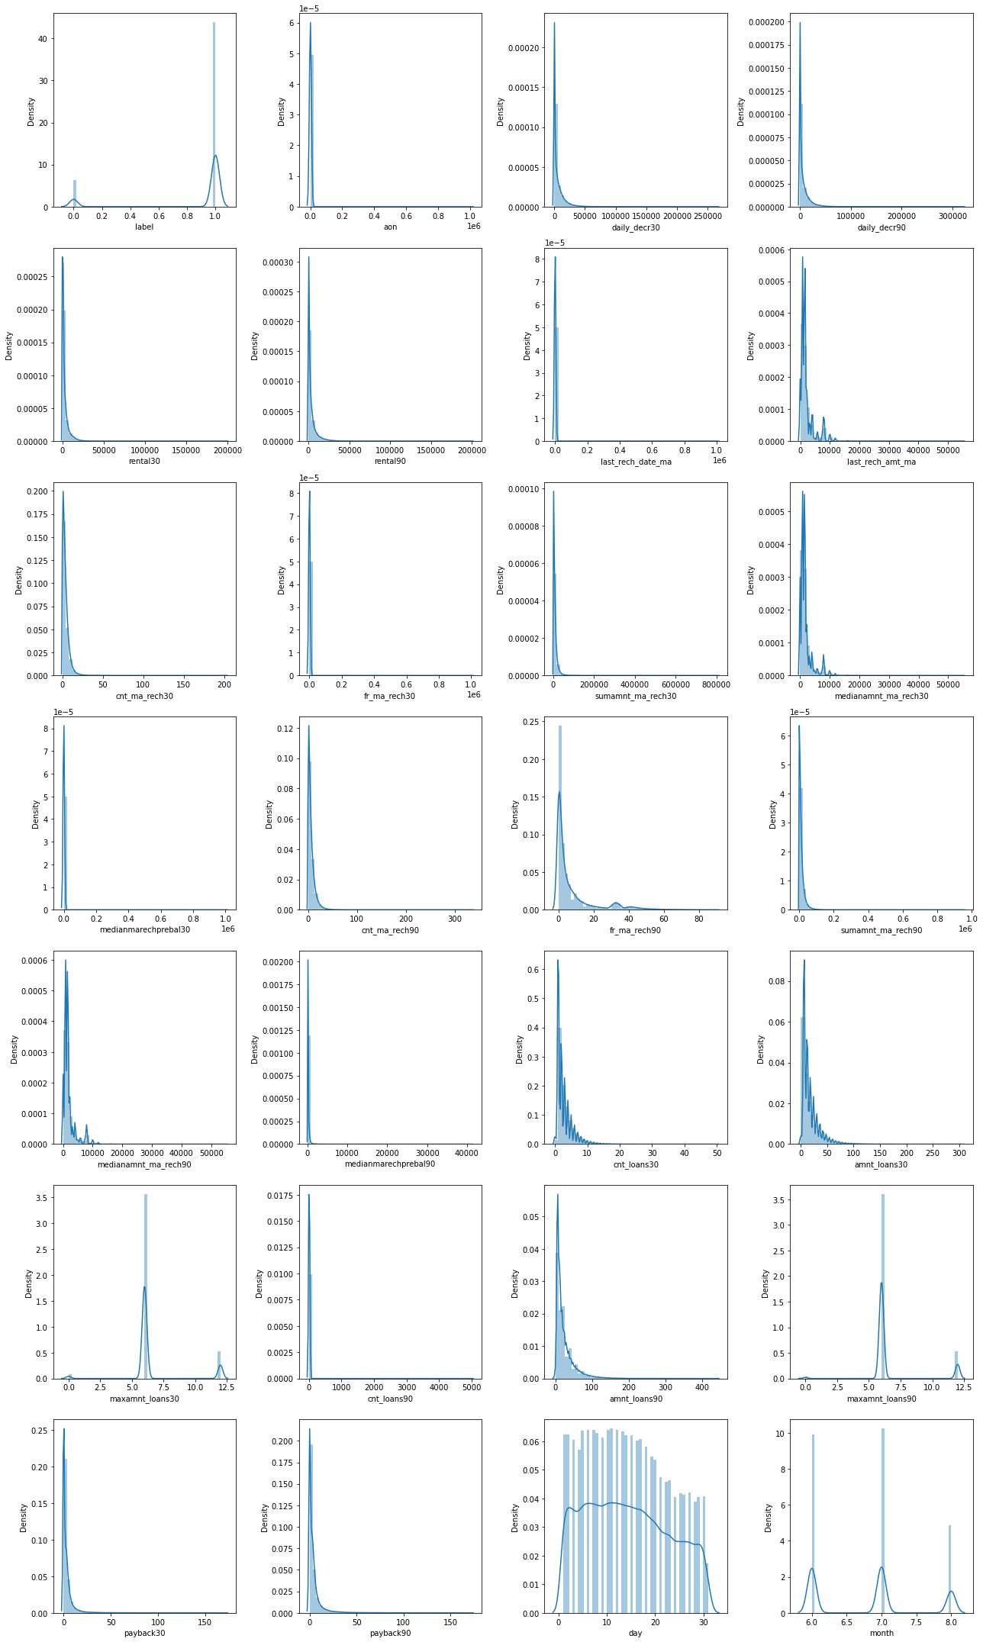
Visualization
In above plots we can see that:
By looking at the above plots we can see that in most of the columns data is not distributed normally as we don’t see a proper bell shaped curve.
In most of the columns data is skewed to right.So to cross verify further i will check the skewness and if the values are more than +0.5or -0.5 than by using power transform method i will treat the skewness.
Distribution Plot

Slide 11
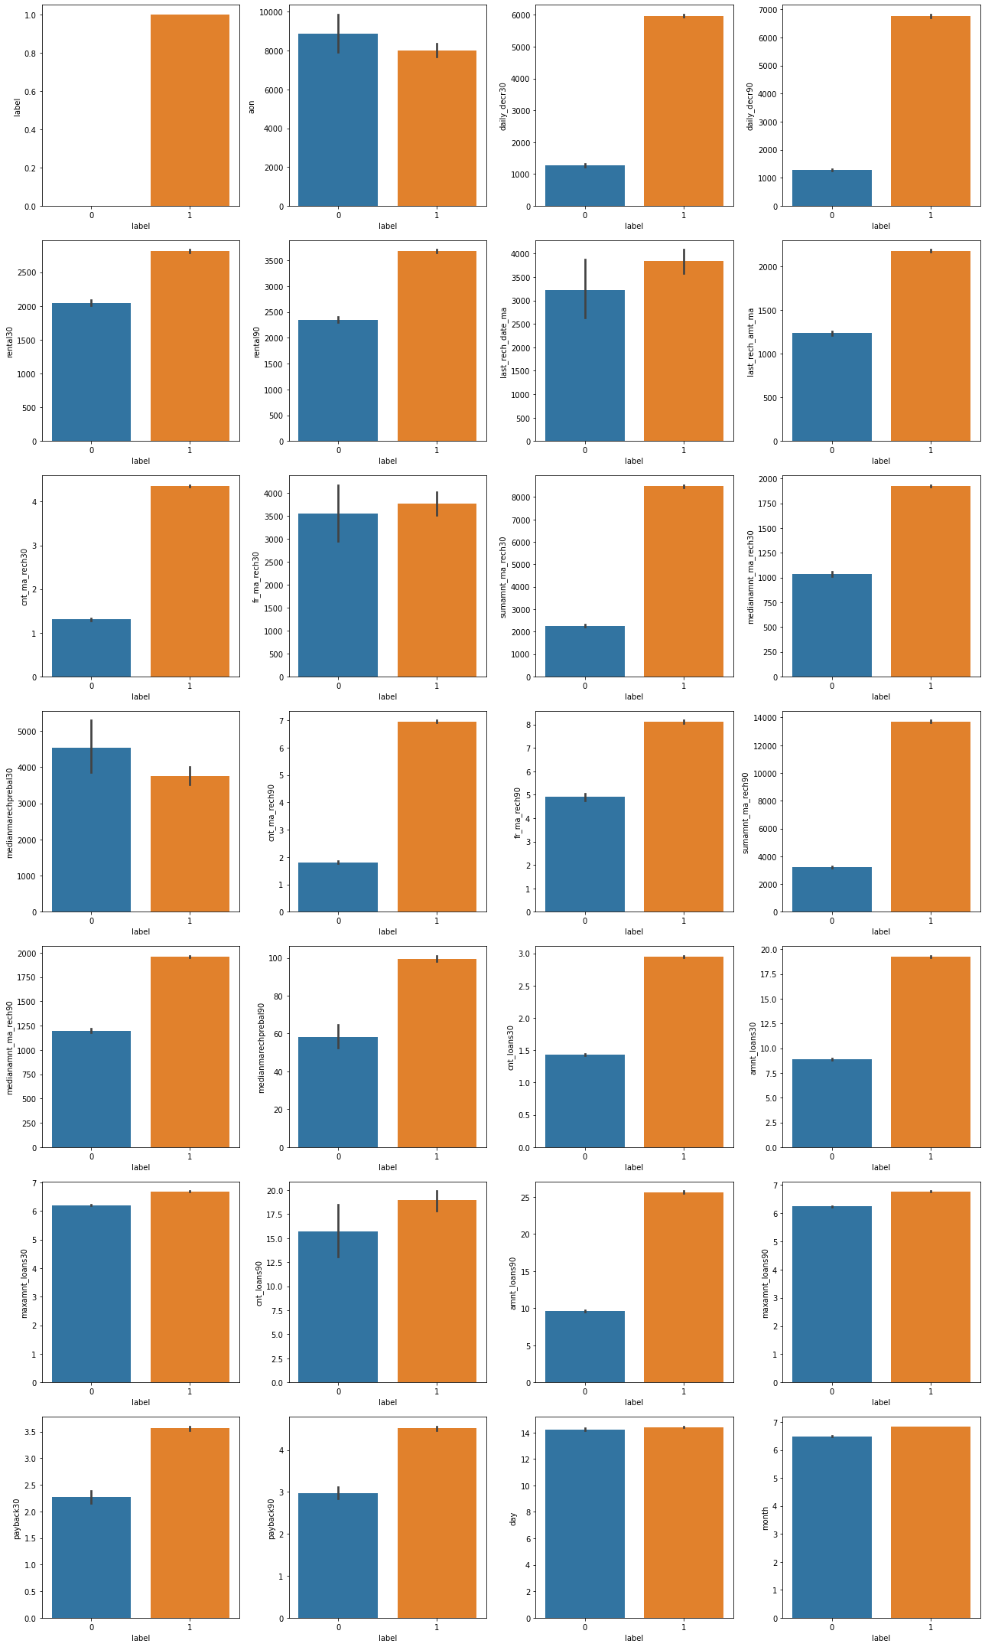
Visualization Cont..
In above plots we can see that:
From the above bar plot that is label vs aon, we can observe that the defaulter rate is higher where the user age on cellular network in days is high.
from the plot label vs daily_decr30 and daily_decr90, we can observe that the users who have spent daily amount from main account over last 30 days and 90 days have always paid back the loan amount within 5 days. May be around 1000 or 1200 users failed to pay back the loan within due date.
By looking at the plot label vs rental20 and rental90, we can observe that non-defaulters average main account balance for 30 and 90 days is more than 2500 and defaulters average main account balance is less than 2500.
By looking at the plot label vs cnt_ma_reach30, we can observe that if the user have recharged more than once than they have paid the loan within 5 days. And if the user have recharge only once than they have not paid the loan within 5days.
By looking at the plot label vs cnt_ma_reach90, we can observe that if the user have recharged more than two times than they have paid the loan within 5 days. And if the user have recharge only two times than they have not paid the loan within 5days.
By looking at the plot label vs fr_ma_reach30 and fr_ma_reach90, we can observe that the frequency of main account recharged in last 30 days is same for defaulters and non-defaulters. While the frequency of main account recharged in last 90 days is increased for non-defaulters compared to defaulters.
By looking at the plot label vs smamnt_ma_reach30, we can observe that the users who failed to pay back the loan within 5 days have less amount of recharge in their main account over last 30 days which is around 2000-2500 (in Indonesian Rupiah). And the users who paid back their loan within 5 days, they have the total amount of recharge in their main account more than 8000 (in Indonesian Rupiah) in last 30 days.
By looking at the plot label vs smamnt_ma_reach30, we can observe that the users who have paid their loan amount within 5 days have the total amount of recharge in their main account more than 12000 (Indonesian Rupiah) in last 90 days while the defaulters have their total amount of recharge in their main account around 2000-4000 (Indonesian Rupiah) over last 90 days.
By looking at the plot label vs meadianamnt_ma_reach30, we can observe that the users who have done their median amount of recharge around 1750-2000 (Indonesian Rupiah) in main account over last 30 days have successfully paid their credit amount within 5 days of issuing loan while the users who have done their median amount recharge around 1000 have failed to pay back the loan within due date.
By looking at the plot label vs meadianamnt_ma_reach90, we can observe that Similar to 30 days data, here also the users who have done their median amount recharge of around 1750-2000 in their main account over last 90 days they have paid back their credit amount within 5 days while the users having their median amount of recharge around 1000-1250 have not paid the loan within 5 days.
By looking at the plot label vs meadianmarechprebal30, we can observe that in 30 days data, the median of main account balance for defaulters are around 4500 (Indonesian Rupiah) which is high compared to non-defaulters. Which means increasing median of main account balance just before recharge in last 30 days at user level, increasing the probability to being defaulter.
By looking at the plot label vs meadianmarechprebal90, we can observe that in last 90 days data, the median of main account balance for non-defaulters are around 100 (Indonesian Rupiah) which is high compared to defaulters. Which means increasing median of main account balance just before recharge in last 90 days at user level, increasing the probability of being non-defaulters.
By looking at the plot label vs cnt_loans30, we can observe that defaulters have taken 1 loan in last 30 days that is when a person takes loan amount for 1 time in last 30 days the chances of not paying back the credit amount are higher. And the users who have paid back the loan, they have taken maximum number of 3 loans in last 30 days data.
Bar Plots
By looking at the plot label vs cnt_loans90, we can observe that in 90 days data, the number of loans taken by the defaulters are highly increasing also increasing the probability to being defaulter. Also, the number of loans taken by non-defaulters being decreased in last 90 days when compared to 30 days data.
By looking at the plot label vs amnt_loans30, we can observe that the total amount of loans taken by the defaulters in last 30 days are in the range of 7.5-10 while the non-defaulters have taken upto 20 loans in last 30 days.
By looking at the plot label vs amnt_loans90, we can observe that the total amount of loans taken by the defaulters in last 90 days are up to 10 and the non-defaulters have taken total amount of loans up to 26 in last 90 days.So, from the above plot we can conclude that when the total number of loans taken by the users in last 90 days is below 10, then the chances of not paying back the loan amount are high.
By looking at the plot label vs maxamnt_loans30 and maxamnt_loans90, we can observe that the maximum amount of loan taken by the user in last 30 days and 90 days are almost same. The maximum amount of loan taken by the defaulters and non-defaulters are up to 6 and 7 respectively in last 30 and 90 days.

Slide 12
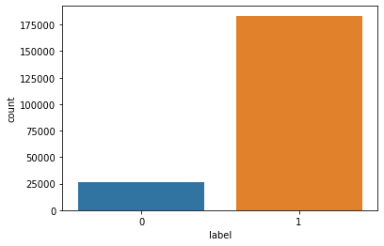
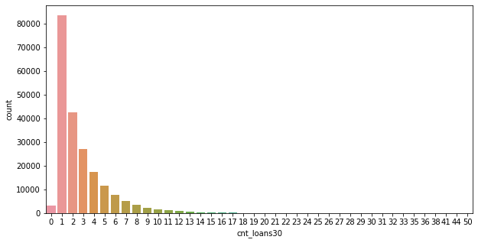
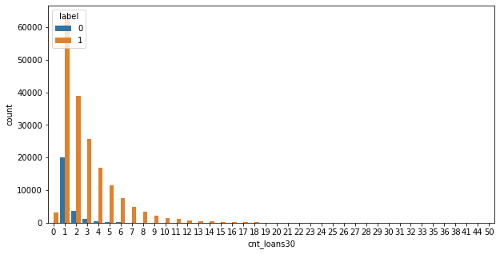
Visualization Cont..
Count Plots
By looking at the plot we can see that the number of non-defaulters are more than that of defaulters in this dataset.
By looking at the plot we can see that most if the people have took loan only once in past 30 days.
By looking at the plot we can see that most of the people who took loan only once in past 30 days.Most of them have paid the loan within 5 days as compared to the ones who have not paid the loan.

Slide 13
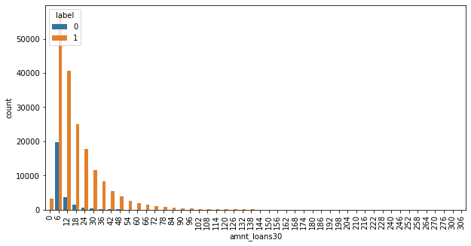
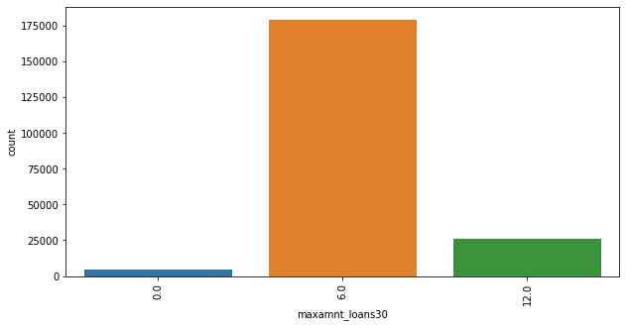
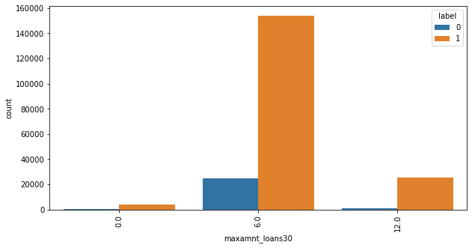
Visualization Cont..
Count Plots
By looking at the plot we can see that most of the people who took maximum amount of loan that is 6(Indonesian Rupiah) for the past 30 days among them most of them have paid the loan within 5 days.
By looking at the plots we can see that most of the people have took a total amount of loan that is 6(Indonesian Rupiah) in past 30 days among which most of them have paid the loan within 5 days as compared to the ones who have not paid the loan.
By looking at the plot we can see that most of the people have took 6(Indonesian Rupiah) as maximum amount of loan for the past 30 days.

Slide 14

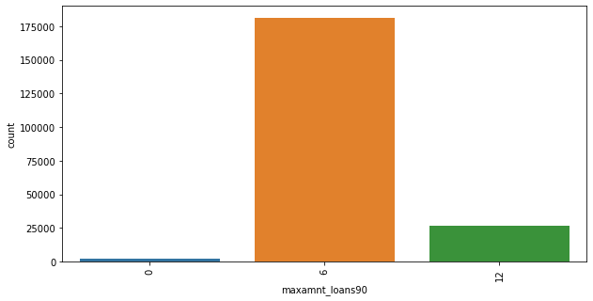
Visualization Cont..
Count Plots
By looking at the plot we can see that most of the people have took a total amount of loan that is 6(Indonesian Rupiah) in past 90 days among which most of them have paid the loan within 5 days as compared to the ones who have not paid the loan.
By looking at the plot we can see that most of the people who took maximum amount of loan that is 6(Indonesian Rupiah) for the past 90 days among them most of them have paid the loan within 5 days.

Slide 15
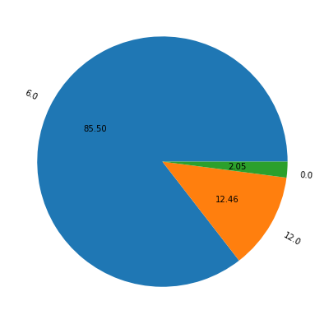
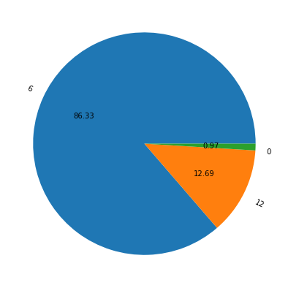
Visualization Cont..
Pie Plot
By looking at the plot we can see that most of the people have took maximum amount of loan that is 6(Indonesian Rupiah) for past 30 days.
By looking at the plot we can see that most of the people have took maximum amount of loan that is 6(Indonesian Rupiah) for past 90 days.

Slide 16
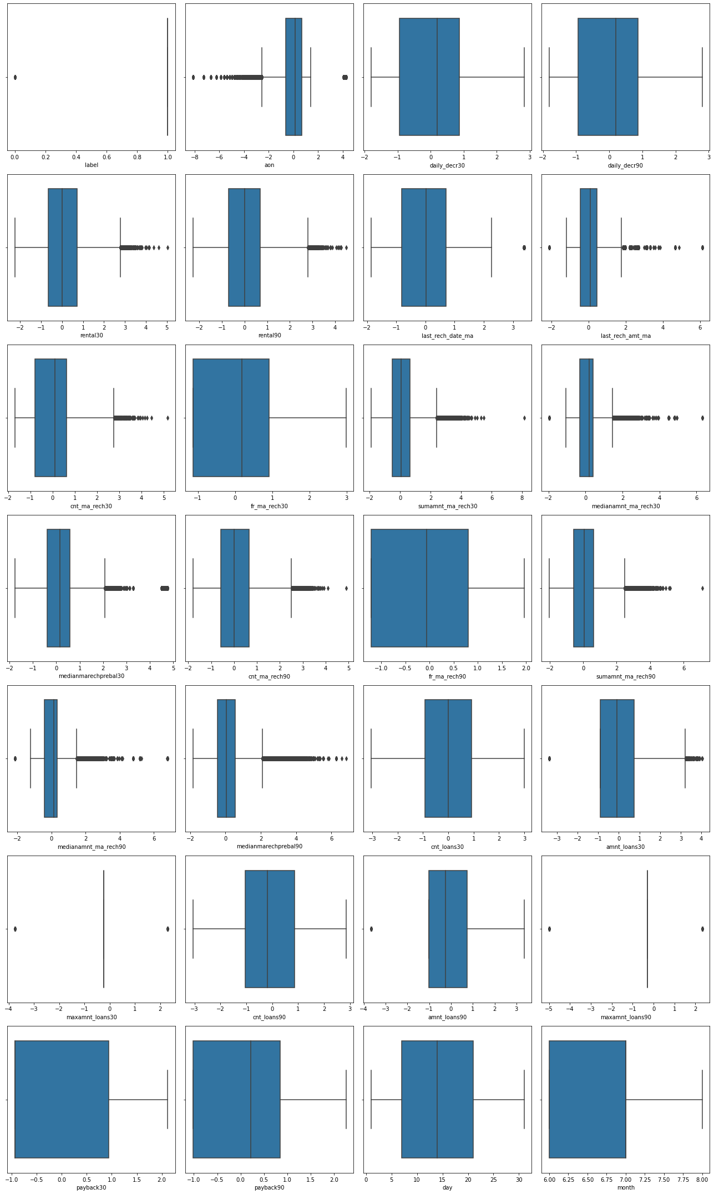
Identifying Outliers Using Box Plots
By looking at the above box plots we can see that except columns daily_decr30, daily_decr90, fr_ma_rech30, fr_ma_rech90, cnt_loans30, cnt_loans90, payback30, payback90,day and month in rest all the columns outliers are present.So using z-score method to remove the outliers.

Slide 17
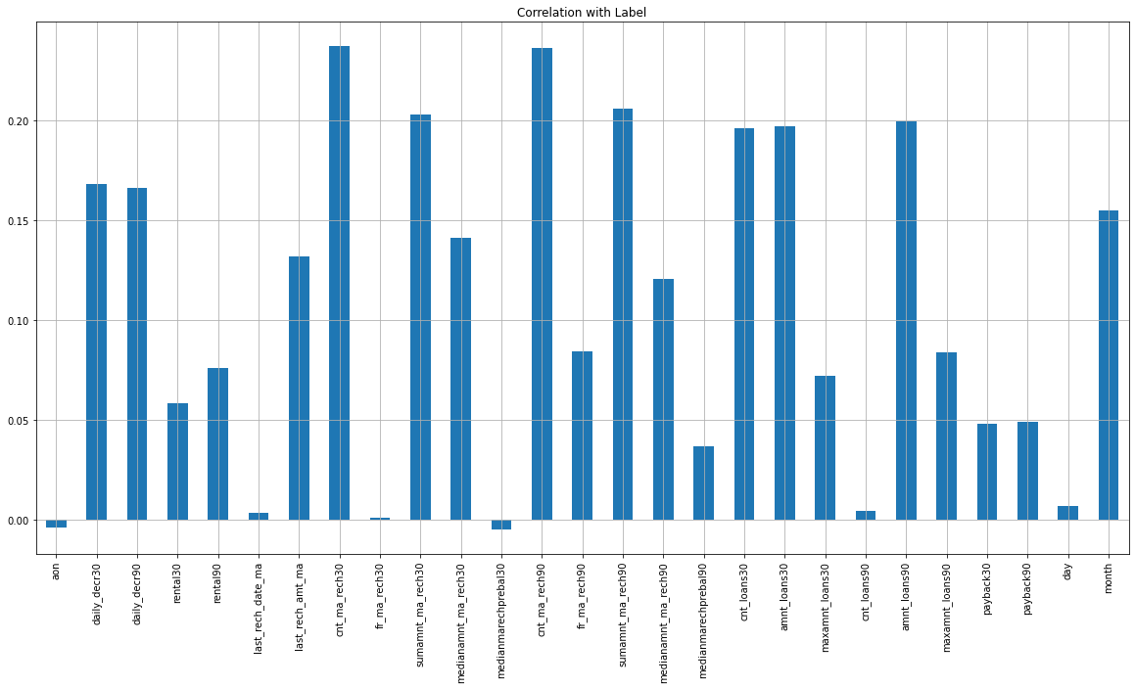
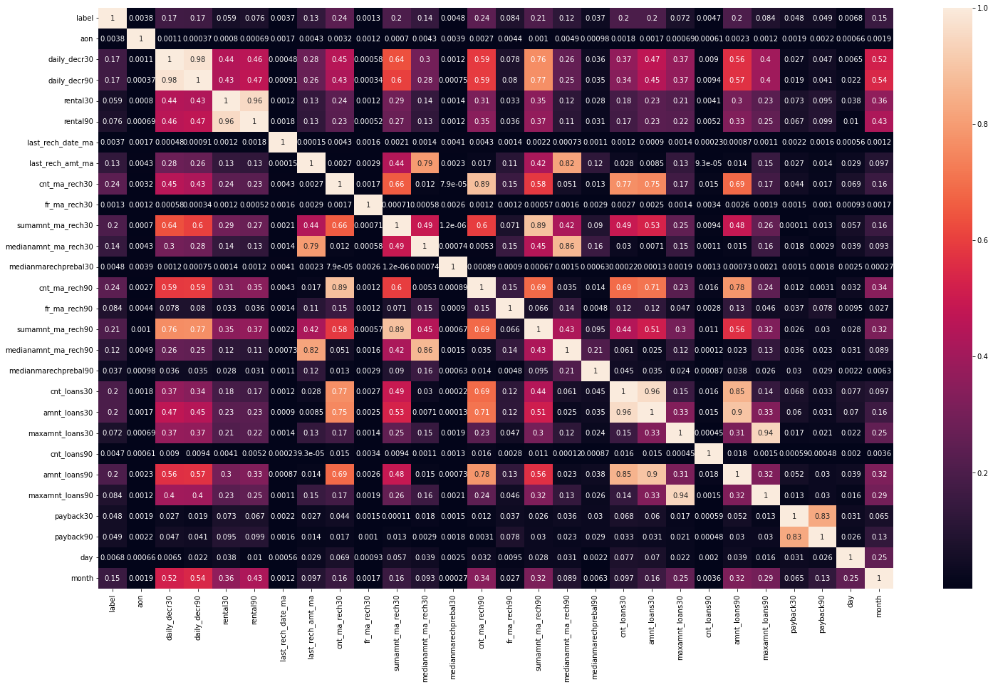
Correlation Between Features And Label
Bar Plot
HeatMap
By looking at the bar plot we can see that features are positively as well as negatively correlated with the label.
By looking at the heatmap we can see if there is any multicollinearity problem between the Features.

Slide 18
Data Analysis Steps Done
To visualize the correlation between the Features and Label and multicollinearity problem i have used bar plot and heatmap.
Skewness was checked and found that in many columns skewness was present so later on it was treated with the help of power transform method.
Used Box plot to check whether there are outliers present or not in continuous data columns. Further found that in many columns outliers were present which were later on removed by using z-score method.
Used Standard Scaler method to standardize the data.
Data of label target variable was not balanced. So by using SMOTE Technique data was balanced.
Split, Train and Test to build the machine learning model. Found best random state and accuracy.

Slide 19
Model Building
Since ‘label’ is my target variable which is categorical in nature, so that we came to know that it is Classification type problem.
After the pre-processing, data cleaning and lastly using PCA Technqiue I left with 20 columns including target. The algorithms used on training the data are as follows:
1.Xtreme Gradient Boosting Classifier(XGB)
2.Ada Boost Classifier
3.Gradient Boosting Classifier
4.Random Forest Classifier
5.Decision Tree Classifier
6.Logistic Regression

Slide 20
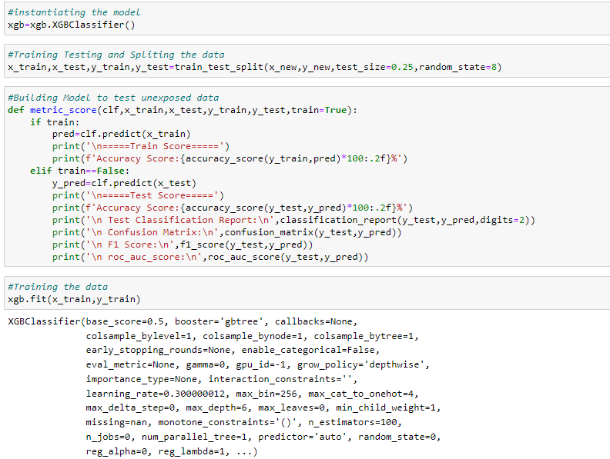
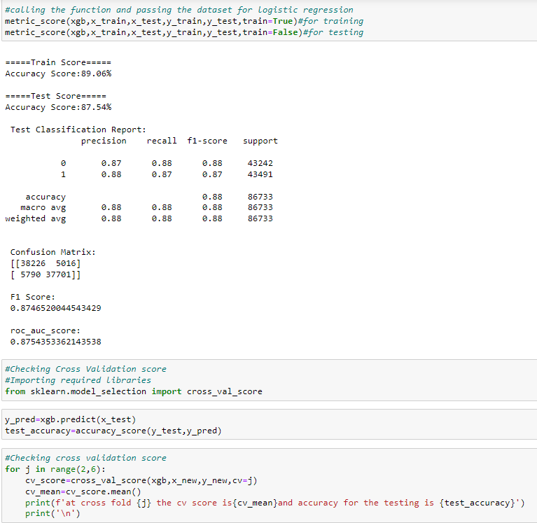
Xtreme Gradient Boosting Classifier
Created XGB Classifier model and checked for its evaluation metrics. The model is giving testing score as 87.54%.

Slide 21
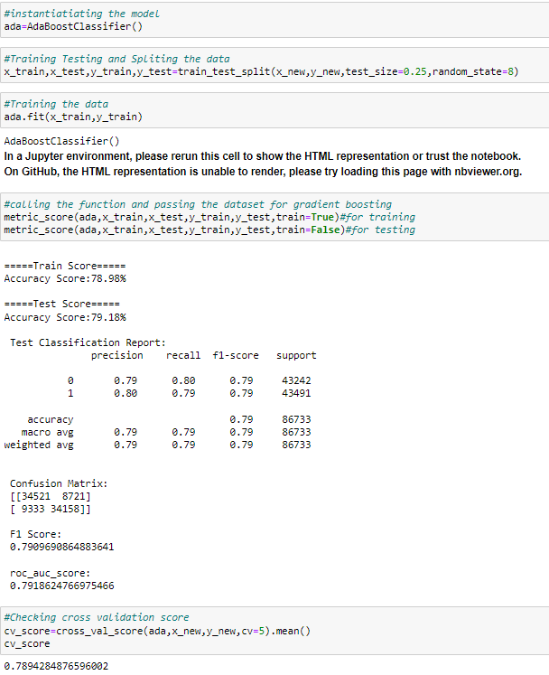
Ada Boost Classifier
Created Ada Boost Classifier model and checked for its evaluation metrics. The model is giving testing score as 79.18%.

Slide 22
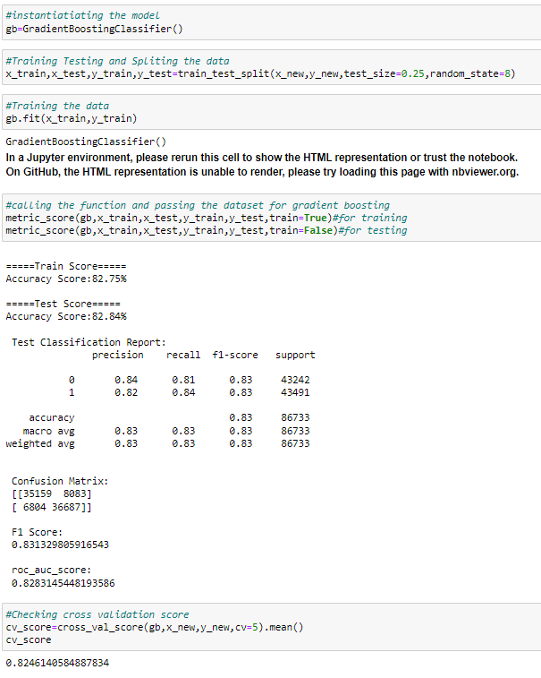
Gradient Boosting Classifier
Created Gradient Boosting Classifier model and checked for its evaluation metrics. The model is giving testing score as 82.54%.

Slide 23
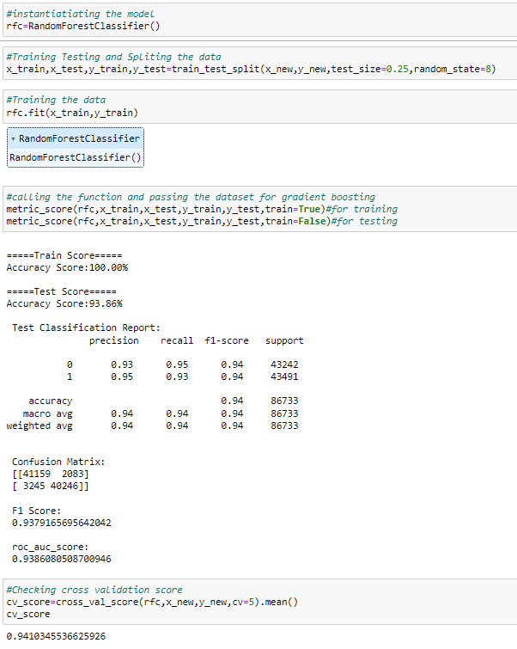
Random Forest Classifier
Created Random Forest Classifier model and checked for its evaluation metrics. The model is giving testing score as 93.86%.

Slide 24
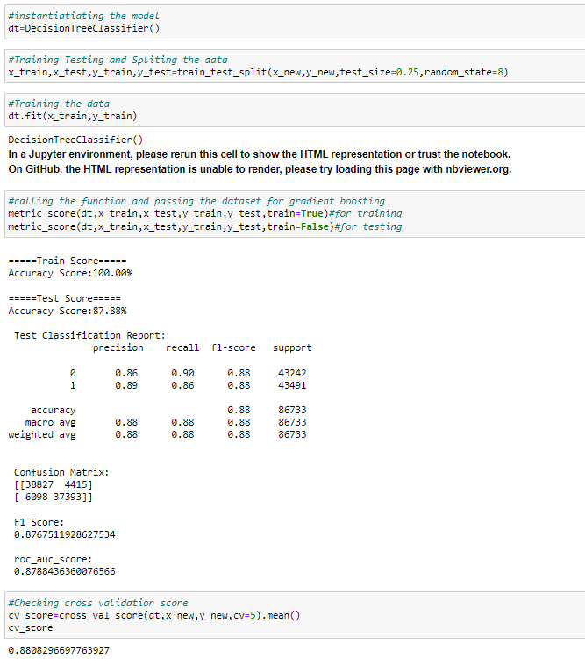
Decision Tree Classifier
Created Decision Tree Classifier model and checked for its evaluation metrics. The model is giving testing score as 87.88%.

Slide 25
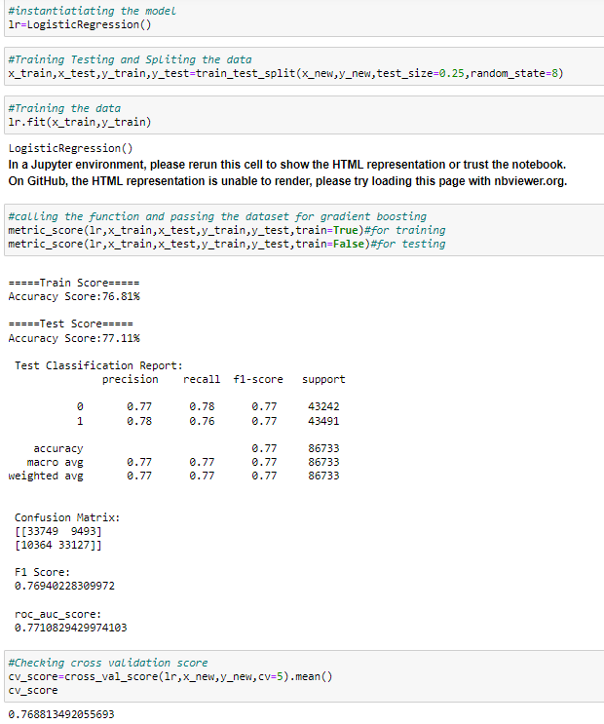
Logistic Regression
Created Logistic Regression model and checked for its evaluation metrics. The model is giving testing score as 77.11%.

Slide 26
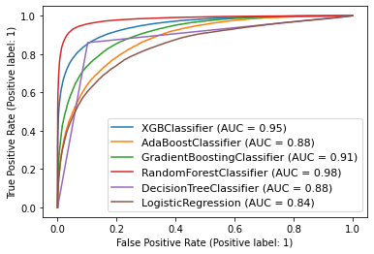
ROC-AUC Curve for all the models
I have generated the ROC Curve for all the models used here and it shows the AUC score for the models.

Slide 27
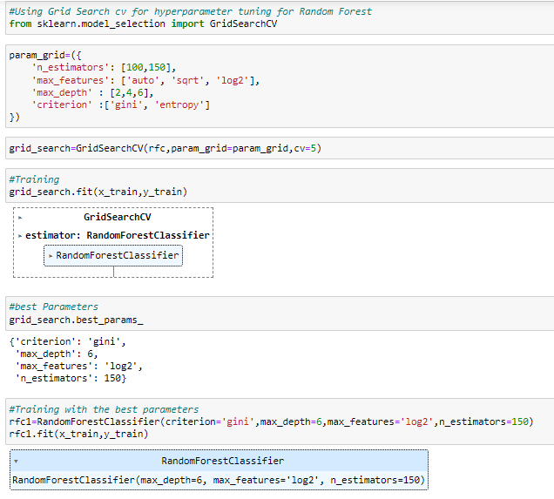
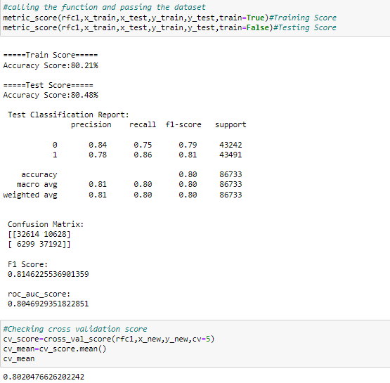
Hyperparameter Tuning And Creating Final Model
I have used Grid Search CV to tuned the model and got the best parameters of Random Forest Classifier And after getting the best parameters used that for building final model to get the best accuracy.
After performing hyper parameter tuning using best parameters of Random Forest Classifier, the training,testing,cross validation and f1-scores reduced.So I am saving the model on which hyper parameter tuning was not done.

Slide 28

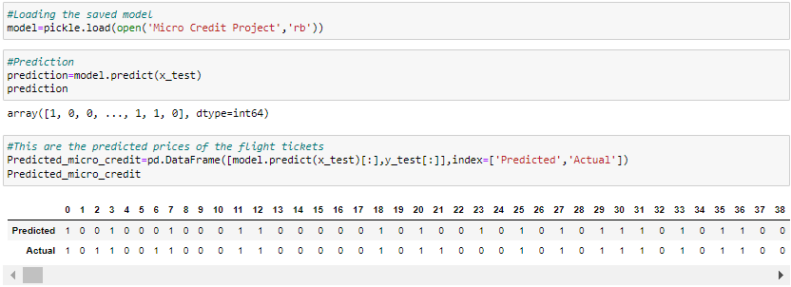
Saving The Model And Prediction From Saved Model
I have saved my final best model using pickle library and loaded saved model for predictions.
we can see the predicted values and actual values of defaulters and non-defaulters.

Slide 29
Conclusion
From the whole study we found that the MFIs have provided loan to the user who have no recharge or balance in their account which needs to be stopped.
Also, the frequency of main account recharged in last 30 days & 90 days we have seen the users with low frequency are causing huge losses, company should implement some kind of strategies to reduce like sending SMS alerts for notification.
We found the defaulting rate is higher in old customers list.
This case study aims to give an idea of applying EDA in a real business scenario. In this case study, apart from applying the techniques that we have learnt in the EDA module, we will also develop a basic understanding of risk analytics in banking and financial services and understand how data is used to minimize the risk of losing money while lending to customers.
From this dataset we were able to understand that the selection of customers for the credit to know whether they are defaulters or non-defaulters are done on the basis of different features.
Overall, we can say that this dataset is good for predicting the defaulters level using classification analysis and conclude that Gradient Boosting Classifier is the best working algorithm model we obtained. We can improve the data by adding some more features.

Slide 30
THANK YOU！

